Slide 1
Chapter 1: The Database Environment and Development Process
Modern Database Management
12th Edition
Jeff Hoffer, Ramesh Venkataraman,
Heikki Topi

Slide 2
Objectives
Define terms
Name limitations of conventional file processing
Explain advantages of databases
Identify costs and risks of databases
List components of database environment
Identify categories of database applications
Describe database system development life cycle
Explain prototyping and agile development approaches
Explain roles of individuals
Explain the three-schema architecture for databases

Slide 3
Definitions
Databases are used to store, manipulate, and retrieve data in nearly every type of organization, including business, health care, education, government, and libraries.
Database: organized collection of logically related data
Data: stored representations of meaningful objects and events
Structured: numbers, text, dates
Unstructured: images, video, documents
Information: data processed to increase knowledge in the person using the data
Metadata: data that describes the properties and context of user data
Notes:
Data by itself is not very useful. It is only after the data has been processed, summarized, and organized that it becomes useful for decision makers and knowledge workers. Processed data becomes information, which is often made available to users in the form of reports or graphical displays.
Metadata really pertains to the underlying structure of the data. When you design a database, you are specifying its metadata. When you populate the database, you are putting data into it.

Slide 4

Figure 1-1a Data in context
Context helps users understand data
Notes:
Here we see a report that indicates several types of data entities. We have courses and sections of these courses, and we also have the students that are enrolled in a section. Thus, we have gone from just raw data to some type of useful information by organizing the data.
The concept of an entity is something we will discuss in detail later on.

Slide 5

Figure 1-1b Summarized data
Graphical displays turn data into useful information that managers can use for decision making and interpretation
Notes:
Here we see summaries of the data. Rather than individual data units, the data has been processed into aggregates and categories. Sums and averages are typical forms of aggregated data, and this is another way of turning raw data into useful and actionable information.

Slide 6
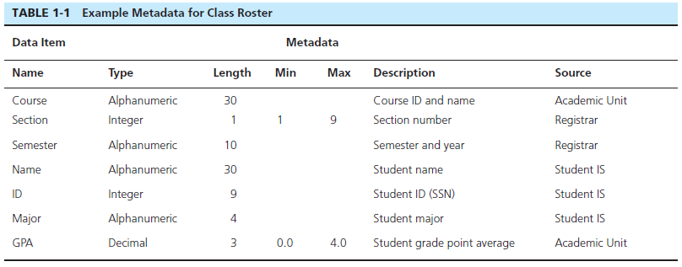
Descriptions of the properties or characteristics of the data, including data types, field sizes, allowable values, and data context
Notes:
Metadata is not data per se. Instead it is a description of how data is to be stored and organized into a database.

Slide 7
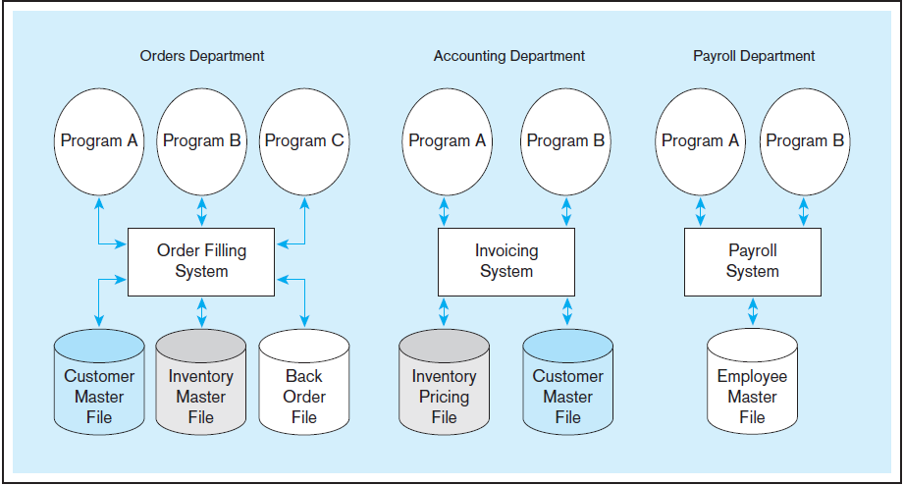
USING TRADITIONAL MANAGEMENT METHOD

Slide 8
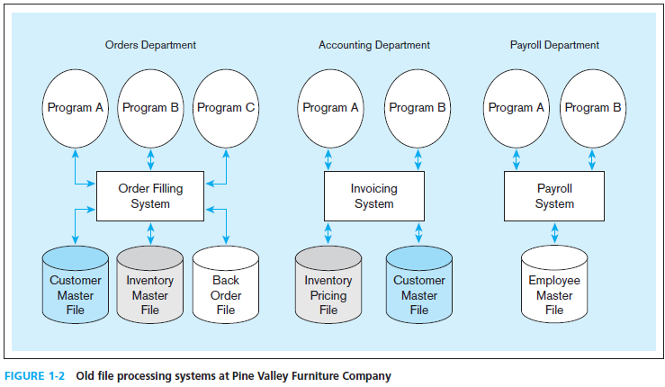
Duplicate Data
Notes:
If the invoicing system and the order filing system each have their own copy of customer data, then this could lead to inconsistencies. What if one file changes the address or account valance of a customer, but the other one does not? In this case, we would have inconsistent data, which is not good for the organization. Data duplication is one of the biggest problems in data management, and databases are designed to eliminate or reduce duplication.
The Pine Valley Furniture (PVF) company will be an ongoing case in this textbook. You will become very familiar with PVF over time.

Slide 9
Disadvantages of File Processing
Program-Data Dependence
All programs maintain metadata for each file they use
Duplication of Data
Different systems/programs have separate copies of the same data
Limited Data Sharing
No centralized control of data
Lengthy Development Times
Programmers must design their own file formats
Excessive Program Maintenance
80% of information systems budget
Notes:
Prior to the advent of databases, data was stored in individual files, each being used by a separate program. This was the traditional file processing approach to data storage. As business applications became more complex, it became evident that traditional file processing systems had a number of shortcomings and limitations. Database systems were developed to overcome these shortcomings. However, there is still a lot of data that is stored in traditional file systems. Legacy systems still abound with traditional files. Even Excel spreadsheets, which are relatively modern, would be considered to fall within the same category as file systems. Many companies store their important data in myriad spreadsheets, and as their businesses become more complex they run up against the limitations of these storage methods.

Slide 10
Problems with Data Dependency
Each application programmer must maintain his/her own data
Each application program needs to include code for the metadata of each file
Each application program must have its own processing routines for reading, inserting, updating, and deleting data
Lack of coordination and central control
Non-standard file formats

Slide 11
Problems with Data Redundancy
Waste of space to have duplicate data
Causes more maintenance headaches
The biggest problem:
Data changes in one file could cause inconsistencies
Compromises in data integrity
Notes:
Although wasted space is an issue with data redundancy, it has become less of a problem over time. Storage media is increasingly becoming less and less expensive.
The real problem, as mentioned earlier, is with data inconsistencies. The term “data integrity” refers to ensuring the validity, security, and availability of a company’s data. Traditional file processing systems have a difficult time ensuring data integrity.

Slide 12
SOLUTION: The DATABASE Approach
Central repository of shared data
Data is managed by a controlling agent
Stored in a standardized, convenient form
Requires a Database Management System (DBMS)

Slide 13
Database Management System
A software system that is used to create, maintain, and provide controlled access to user databases
Order Filing
System
Central database
Contains employee,
order, inventory,
pricing, and
customer data
Invoicing
System
DBMS
Payroll
System
DBMS manages data resources like an operating system manages hardware resources
Notes:
The database management system (DBMS) is a software system that is used to create, maintain, and provide controlled access to user databases.
Most current DBMSs are in the form of relational databases, which represent data as a collection of tables in which all data relationships are represented by common values in related tables. We will explore relational databases in detail throughout this course.
Note that because all the data is shared in a central database, there is no longer the need for separate systems and programs to maintain their own copy of the data. This reduces duplication and increases integrity.

Slide 14
Elements of the Database Approach
Data models
Graphical diagram capturing nature and relationship of data
Enterprise Data Model–high-level entities and relationships for the organization
Project Data Model–more detailed view, matching data structure in database or data warehouse
Entities
Noun form describing a person, place, object, event, or concept
Composed of attributes
Relationships
Between entities
Usually one-to-many (1:M) or many-to-many (M:N), but could also be one-to-one (1:1)
Relational Databases
Database technology involving tables (relations) representing entities and primary/foreign keys representing relationships

Slide 15
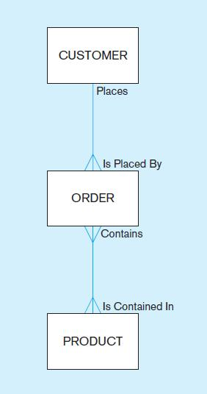
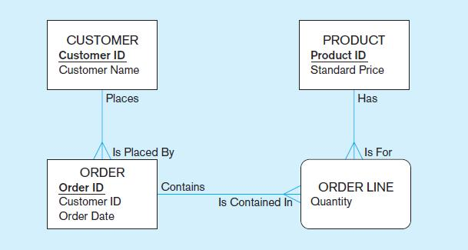
Figure 1-3 Comparison of enterprise and project level data models
Segment of an enterprise data model
Segment of a project-level data model
Notes:
Here we see the distinction between an enterprise data model and a project data model. The enterprise-level model is more of a bird’s eye view, and less detailed than a project-level model.
Entities are represented by boxes. Relationships are represented by lines between the boxes. Attributes, which describe the important characteristics of an entity, are represented by the verbiage within the boxes.

Slide 16
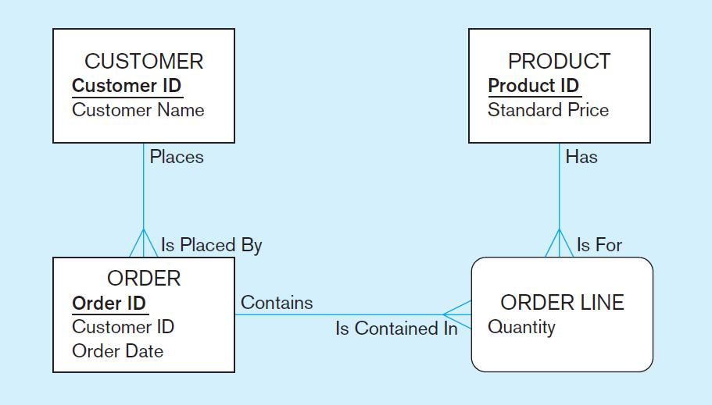
One customer may place many orders, but each order is placed by a single customer
→ One-to-many relationship
Notes:
The relationship between customers and orders is one-to-many. The crows feet of the relationship line indicates the many side of the relationship.

Slide 17
One order has many order lines; each order line is associated with a single order
→ One-to-many relationship
Notes:
Here we see another one-to-many relationship, this time between orders and order lines.
Note that some of the attributes are underlined and in bold. This typically represents an identifier attribute, which is a unique identifier of the entity. For example, only one customer can have a particular customer ID.

Slide 18
One product can be in many order lines, each order line refers to a single product
→ One-to-many relationship
Notes:
Another one-to-many (M:N) relationship. There may be several order line for the same product. But each order line belongs is associated with only one product.

Slide 19
Therefore, one order involves many products and one product is involved in many orders
→ Many-to-many relationship
Notes:
Notice that the Order Line entity has curved corners. This is the symbol of an “associative entity”, so called because it’s main purpose is to represent an association between two other entities. A particular order can involve purchase of many products. Also, a particular product could be involved in many orders. In a sense an associative entity could be thought of as a combination entity/relationship.
We will discuss many of these concepts in detail when we get to chapter 2.

Slide 20
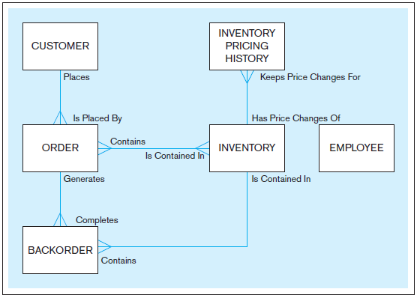

Notes:
Note that the enterprise model doesn’t contain some details, including the attributes of the entities, as well as the associative entities. In this sense it is a more summarized view, and simpler to look at. This is in contrast to the project-level model which is much more detailed.

Slide 21
Database management system
A database management system (DBMS) is a software system that enables the use of a database approach. The primary purpose of a DBMS is to provide a systematic method of creating, updating, storing, and retrieving the data stored in a database

Slide 22
Advantages of THE DatabaSE APPROACH
Program-data independence
Planned data redundancy
Improved data consistency
Improved data sharing
Increased application development productivity
Enforcement of standards
Improved data quality
Improved data accessibility and responsiveness
Reduced program maintenance
Improved decision support
Notes:
There are many advantages of databases of traditional files.
Program-data independence: Separate program and data into different files.
Planned data redundancy: Allow minimize and control type and amount of database redundancy.
Improved data consistency: Change in one place only.
Improved data sharing: Allow only-specified permission to change the database.
Increase productivity: Reduce time and cost, since database and program are separated.
Enforcement of standard : force naming conventions, data quality standards, and uniform procedures for accessing, updating, and protecting data
Improved data quality: Constraint, one user has order, no order has no user.
Improved data accessibility and responsiveness: Can use query to retrieve result, even for novice user.
Reduce maintenance: Data always change, if program and data depends, maintenance cost and time are large, since it ties.
Improved decision support: Some database support various field of interest, such as finance, supply chain management.

Slide 23
Costs and Risks of the Database Approach
New, specialized personnel
Installation and management cost and complexity (training, infrastructure)
Conversion costs
Need for explicit backup and recovery
Organizational conflict
Notes:
But there are also costs and risks. It is not an easy thing to convert from traditional file processing systems to databases. Although the end result is usually beneficial to the organization, the costs of converting are significant, especially for a large company.

Slide 24
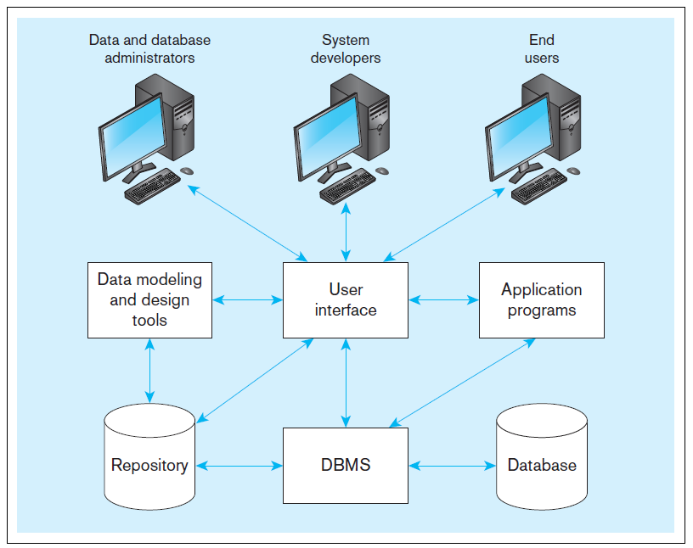
Figure 1-5 Components of the database environment
Notes:
Data modeling and design tools are automated tools used to design databases and application programs. These tools help with creation of data models and in some cases can also help automatically generate the “code” needed to create the database.
A repository is a centralized knowledge base for all data definitions, data relationships, screen and report formats, and other system components. In other words, the metadata resides in the repository.
DBMS is a software system that is used to create, maintain, and provide controlled access to databases. A database is an organized collection of logically related data, usually designed to meet the information needs of multiple users in an organization. A database is not the same as a repository. The database contains data, whereas the repository contains metadata. In other words, the repository defines the structure of the data.
Application programs interact with the database to provide functionality of use for the company. Relating this to figure 1-2, the application programs fulfill the order processing, invoicing, and payroll functions.
The user interface includes languages, menus, and other facilities by which users interact with various system components. Most application programs will involve user interfaces, because they will be directly used by people (users). However, not all applications involve user interfaces; some are run as batch programs in the background. For example, a program that prints paychecks may not include a user interface.
Different types of users include data and database administrators, system developers, and end users. The data administrators manage the data and database. The developers create the application programs. The end users are peope who use the systems for various business functions. These can include accountants, sales people, managers, etc. Database administrators and system developers are IT people, and their principal clientele involve end users.

Slide 25
Components of the Database Environment
C.A.S.E. tools-- automated tools used to design databases and application programs (even code generation).
Repository–centralized storehouse of metadata
Database Management System (DBMS) –software for managing the database
Database–storehouse of the data
Application Programs–software using the data
User Interface–text, graphical displays, menus, etc. for user
Data/Database Administrators–personnel responsible for maintaining the database
System Developers–personnel responsible for designing databases and software
End Users–people who use the applications and databases

Slide 26

Enterprise Data Model
First step in the database development process
Specifies scope and general content
Overall picture of organizational data at high level of abstraction
Entity-relationship diagram
Descriptions of entity types
Relationships between entities
Business rules

Slide 27
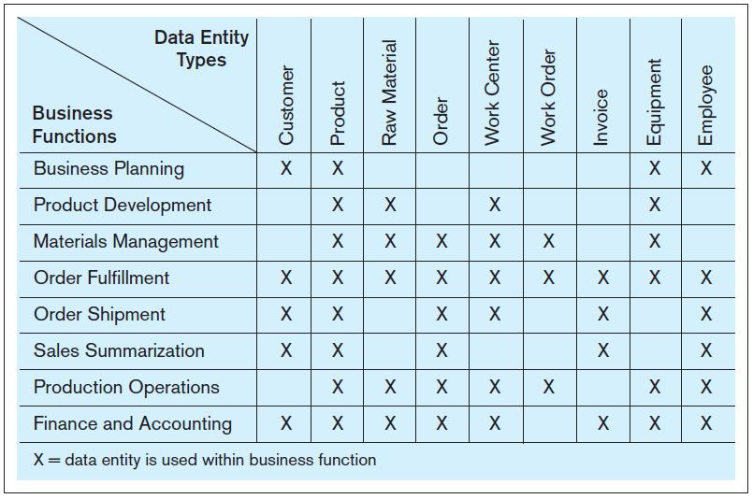
FIGURE 1-6 Example business function-to-data entity matrix
Notes:
How do we determine the type of data that is required and who within the organization needs what data? Often this is done using matrixes. One type of matrix matches business functions with the data entity types they need; this is called a function-to-data-entity matrix.

Slide 28
Two Approaches to Database and IS Development
SDLC
System Development Life Cycle
Detailed, well-planned development process
Time-consuming, but comprehensive
Long development cycle
Prototyping
Rapid application development (RAD)
Cursory attempt at conceptual data modeling
Define database during development of initial prototype
Repeat implementation and maintenance activities with new prototype versions
Notes:
The traditional SDLC came from the days before advanced technologies made rapid application development possible. Prototyping and its variants (such as agile, scrum, and extreme programming) came about much later in the history of information technology. Many projects combine various elements from SDLC and prototyping. In the next set of slides we’ll look at the steps in each approach.

Slide 29
Systems Development Life Cycle (see also Figure 1-7)
Planning
Analysis
Logical Design
Physical Design
Implementation
Maintenance
Notes:
The SDLC is sometimes called a “waterfall” approach. The outputs from one phase flow down to the next. But as you can see it is also a cycle. At any stage in the process, it is possible and sometimes necessary to return to a prior stage.

Slide 30
Systems Development Life Cycle (see also Figure 1-7) (cont.)
Planning
Purpose–preliminary understanding
Deliverable–request for study
Planning
Analysis
Logical Design
Physical Design
Database activity–
enterprise modeling and early conceptual data modeling
Implementation
Maintenance
Notes:
Each of these slides show the general purposes and deliverables from a phase in the top right corner. This applies to all types of system development, not just databases. In the lower left we see the database-specific activities. As we saw in previous slides, the first step involves enterprise modeling. In terms of early conceptual data modeling, we will be a high level, so we will likely be creating enterprise-level models, not project-level.

Slide 31
Systems Development Life Cycle (see also Figure 1-7) (cont.)
Purpose–thorough requirements analysis and structuring
Deliverable–functional system specifications
Planning
Analysis
Analysis
Logical Design
Physical Design
Database activity–thorough and integrated conceptual data modeling
Implementation
Maintenance
Notes:
After planning comes a more in-depth study called analysis. The data models developed here are more detailed (project-level), including more entities, attributes and relationships than the enterprise models.
Analysis includes detailed study, interviews, requirements elicitation, and document review, as well as studying the current system. The output from this involves a detailed set of specifications for what the desired system should do.

Slide 32
Systems Development Life Cycle (see also Figure 1-7) (cont.)
Purpose–information requirements elicitation and structure
Deliverable–detailed design specifications
Planning
Analysis
Logical Design
Logical Design
Physical Design
Database activity–
logical database design (transactions, forms, displays, views, data integrity and security)
Implementation
Maintenance
Notes:
Whereas analysis involves identifying what the system should do, the logical design is concerned with specifying how the system is going to do it. From a database perspective, analysis involves drawing the various entity-relationship data models, whereas logical design involves defining the tables, screenshots, metadata, etc. of the finalized system.

Slide 33
Systems Development Life Cycle (see also Figure 1-7) (cont.)
Purpose–develop technology and organizational specifications
Deliverable–program/data structures, technology purchases, organization redesigns
Planning
Analysis
Logical Design
Physical Design
Physical Design
Database activity–
physical database design (define database to DBMS, physical data organization, database processing programs)
Implementation
Maintenance
Notes:
After logical design comes physical design. This can include the development or acquisition of application programs. From a database perspective, we have decided on the physical database platform (e.g. Oracle, SQL Server, mySql) and written much of the SQL for actually creating and manipulating our data structure.

Slide 34
Systems Development Life Cycle (see also Figure 1-7) (cont.)
Purpose–programming, testing, training, installation, documenting
Deliverable–operational programs, documentation, training materials
Planning
Analysis
Logical Design
Physical Design
Database activity–
database implementation, including coded programs, documentation, installation and conversion
Implementation
Implementation
Maintenance
Notes:
Often “physical design” and “implementation” overlap. There’s still programming and more SQL that takes place during implementation. But other activities include installing the finished product on the production environment (previously it was only in test), and also preparing users through documentation and training. At the end of implementation is when the system is actually “up and running”.

Slide 35
Systems Development Life Cycle (see also Figure 1-7) (cont.)
Planning
Purpose–monitor, repair, enhance
Deliverable–periodic audits
Analysis
Logical Design
Physical Design
Database activity–
database maintenance, performance analysis and tuning, error corrections
Implementation
Maintenance
Maintenance
Notes:
After implementation comes maintenance. This is typically by far the longest phase, because maintenance lasts throughout the life time of the operational system. During this time there will be needs for enhancements, bug fixes, and problem-solving of various sorts. Sometimes you can think of enhancements as little mini-SDLCs that produce the needed improvements to the system.

Slide 36
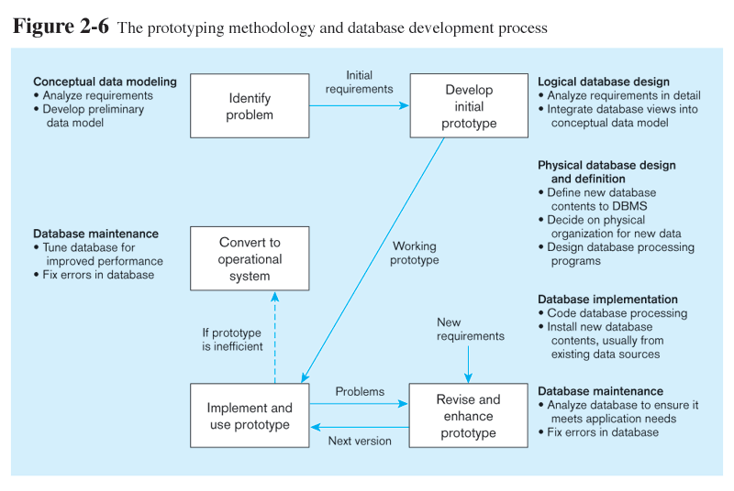
Prototyping Database Methodology (Figure 1-8)
Prototyping is a classical Rapid Application Development (RAD) approach
Notes:
Prototyping takes a different approach to system development. It is less formal and more ad hoc, involving iterations of coding and using and evolving. The concept of prototyping has evolved into several rapid application development variations, as we’ll discuss later.
Unlike the traditional SDLC, there is less of an emphasis on up-front planning and analysis and more of an experimentation flavor to the development process.

Slide 37
Prototyping Database Methodology (Figure 1-8)
Notes:
First, you identify the problem. This is sort of a condensed blend of the planning an analysis phases of the SDLC. Out of this comes initial requirements.
The database activity for this phase is to come up with ER models. But these are much less formalized an complete than in a typical SDLC. They serve more as “sketches” of the system, with the understanding that these sketches wiil evolve over time.

Slide 38
Prototyping Database Methodology (Figure 1-8)
Notes:
Based on the ER models and system requirements develop the initial prototype. Her you dive right into coding and development. This is like logical design, physical design, and implementation rolled into one.

Slide 39
Prototyping Database Methodology (Figure 1-8)
Notes:
This is followed by a series of iterations where you use the prototype, then modify it, then use it, then modify it. Hopefully, by the end of the process, you can use the system.
But even if the system can’t be used do to scalability of efficiency reasons, it provides a starting point for developing the operational system.

Slide 40
Prototyping Database Methodology (Figure 1-8)
Notes:
Database maintenance will occur throughout the operational lifetime of the system, just like in the SDLC methodology.

Slide 41
Other Rapid Application (RAD) Approaches
Agile – emphasizes “individuals and interactions over processes and tools, working software over comprehensive documentation, customer collaboration over contract negotiation, and response to change over following a plan.” (The Agile Manifesto)
Examples of agile programming methodologies
eXtreme programming
Scrum
DSDM Consortium
Feature-driven development
Notes:
Prototyping led to many RAD approaches. The “Agile Manifesto” was a statement that espoused a radical free-flowing and flexible approach to systems development. Here is a list of some of the methodologies.

Slide 42
Database Schema
External Schema
User Views
Subsets of Conceptual Schema
Can be determined from business-function/data entity matrices
DBA determines schema for different users
Conceptual Schema
E-R models–covered in Chapters 2 and 3
Internal Schema
Logical structures–covered in Chapter 4
Physical structures–covered in Chapter 5
Notes:
The term “schema” here refers to the view you have of the system being developed. Users of a system have one view, based on the reports, forms, and interactions they have with the system. Designers have s view of the entities, attributes, and relationships involved in the world being modeled (the conceptual schema), as well as a view of tables, fields, primary and foreign keys, together with an understanding of what makes a database well structured and efficient (the internal schema).

Slide 43
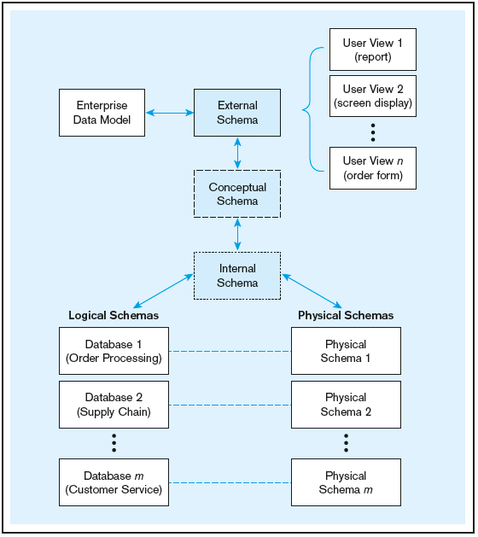
Figure 1-9 Three-schema architecture
Different people have different views of the database…these are the external schema
The internal schema is the underlying design and implementation
Notes:
If you are a database designer, you will be extensively involved in the conceptual schema logical and physical pieces of the internal schema. You will be particularly involved in the physical schema if you are a database administrator (DBA). If you are a user, these schemas don’t matter much to you; rather you will be involved in the external schema.

Slide 44
Managing People and Projects
Project–a planned undertaking of related activities to reach an objective that has a beginning and an end
Initiated and planned in planning stage of SDLC
Executed during analysis, design, and implementation
Closed at the end of implementation
Notes:
Project management is an important skill in any information systems project, and managing the database design and implementation tasks is part of project management.
Projects often are organized into tasks and subtasks, each of which is scheduled for an expected time period, and assigned to various people involved in the project. It is up to the project manager to monitor the progress and cost of the project.

Slide 45
Managing Projects: People Involved
Business analysts
Systems analysts
Database analysts and data modelers
Users
Programmers
Database architects
Data administrators
Project managers
Other technical experts
Notes:
There are many different people, each with different perspectives, skills, and needs, involved in a systems development project.

Slide 46
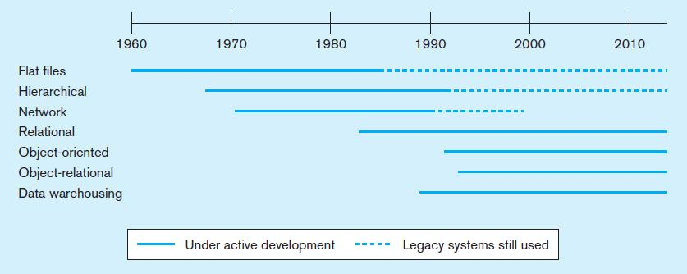
Figure 1-10a Evolution of database technologies
Notes:
Over the years since the advent of computer data processing systems in business, there have been many approaches to database technology. We already discussed flat files and their problems. Early attempts to solve these problems led to hierarchical and network databases. Legacy systems, those initially created in the 1950s and 1960s sometimes still use these earlier technologies.
The relational database is the most common form, especially for business applications. However, others also exist, including object-oriented and object-relational. Data warehousing is commonly used for managerial decision making.

Slide 47
Evolution of Database Systems
Driven by four main objectives:
Need for program-data independence ➔ reduced maintenance
Desire to manage more complex data types and structures
Ease of data access for less technical personnel
Need for more powerful decision support platforms
Notes:
Here are some of the motivations that led to the evolution of database systems.

Slide 48
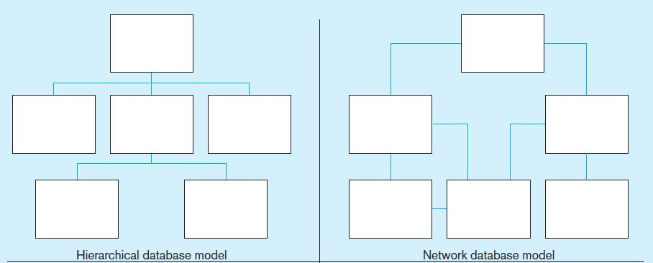
Figure 1-10b Database architectures
Notes:
The hierarchical and network database models was the first attempt to structure data according to relationships between entities. But they fell short because they were very inflexible. For example, many-to-many relationships are impossible in hierarchical databases, and although they are possible in network models they are difficult to modify in these structures.

Slide 49
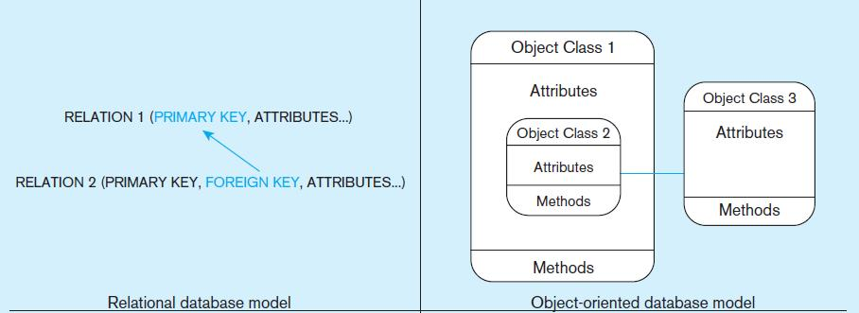
Figure 1-10b Database architectures (cont.)
Notes:
The relational model is the most ubiquitous, and represents relationships as primary-to-foreign key associations in different “relations”. Here we see some confusing terminology. There is the concept of “relationship”, which was shown as lines between boxes in figure 1-3. And there is another concept of “relation”, which is really like a database table. We’ll see this distinction later in the semester.
Object-oriented databases are interesting in that they allow for a sort of inheritance between classes and subclasses. Also, unlike relations (tables) in relational databases, objects in object-oriented databases are capable of behaviors (program code) in the form of “methods”. If you take a course in Java or another object-oriented language, you will become familiar with these ideas.

Slide 50
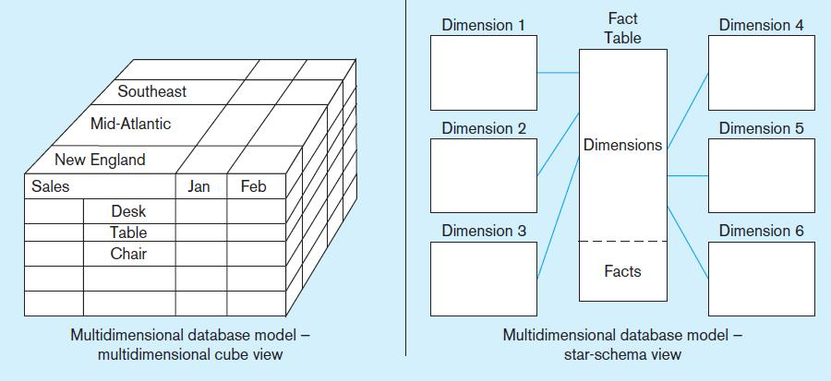
Figure 1-10b Database architectures (cont.)
Notes:
Multidimensional models are typically based on data warehouses, and are used for decision support purposes. The term Online Analytical Processing (OLAP) refers to the types of systems that use multidimensional data.

Slide 51
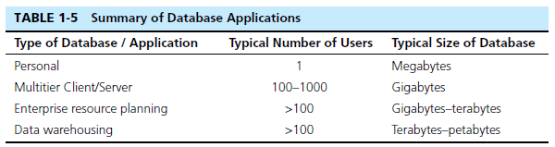
The Range of Database Applications
Personal databases
Two-tier and N-tier Client/Server databases
Enterprise applications
Enterprise resource planning (ERP) systems
Data warehousing implementations
Notes:
Here are some size ranges of typical database applications. Personal databases are often done in Microsoft Access. Multitier client/server and ERP systems are typical for the normal operational activities of most companies. Data warehouses tend to be large because they collect and maintain historical data over time.

Slide 52
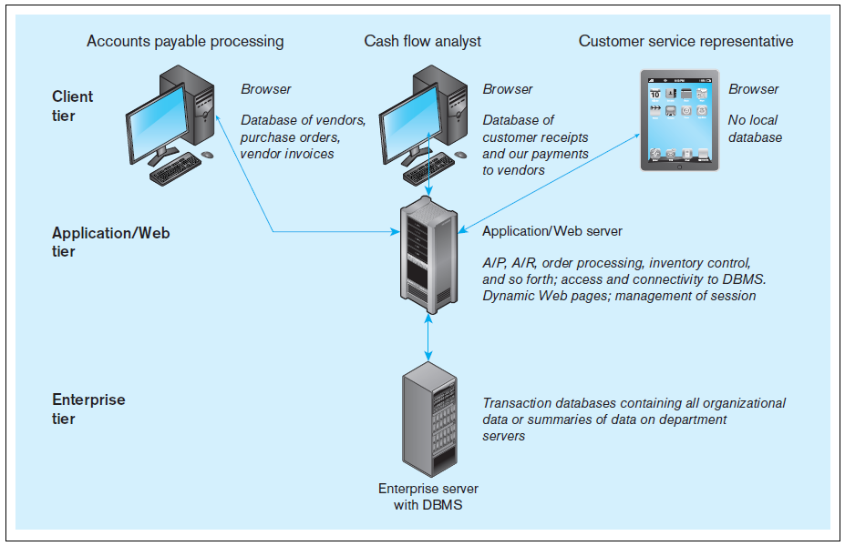
Figure 1-11 Multi-tiered client/server database architecture
Notes:
When we get to chapter 8, we will see how databases are used in applications. Most web applications follow the 3-tier approach. Databases are typically at an enterprise tier, application program code is at an application/Web tier, and user interfaces for different users are at the client tier.

Slide 53
Enterprise Database Applications
Enterprise Resource Planning (ERP)
Integrate all enterprise functions (manufacturing, finance, sales, marketing, inventory, accounting, human resources)
Data Warehouse
Integrated decision support system derived from various operational databases
Notes:
Data warehouse:
+ Truy cập dễ dàng: + Thông tin nhất quán: + Thích nghi với thay đổi: + Bảo mật: + Hỗ trợ ra quyết định:

Slide 54
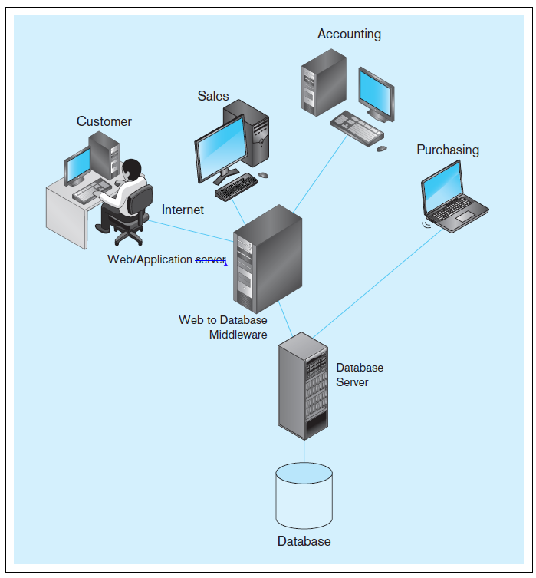
FIGURE 1-13 Computer
System for Pine Valley
Furniture Company
Notes:
Throughout the textbook, you will see many descriptions of Pine Valley Furniture. This figure shows a typical system configuration. Note the 3-tier architecture, with a database server, an application server, and client workstations for customers and employees in different departments.

Slide 55
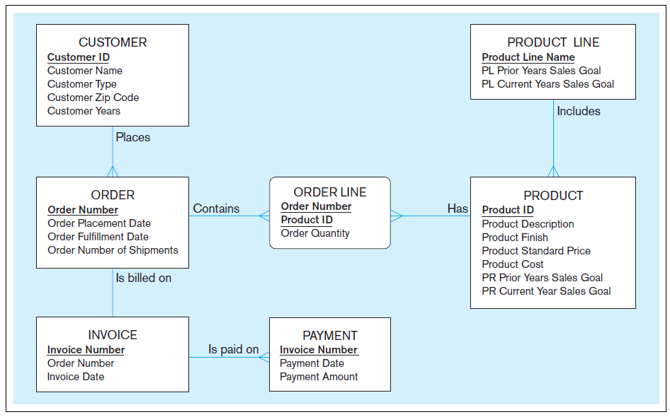
FIGURE 1-15 Project data model for Home Office product line marketing support system
Notes:
This data model shows some of the main entities for PVF, as well as their attributes and relationships. Over time you will see many other diagrams and descriptions of PVF.

